Slide 1
Getting started with intelliJ IDEA
Submitted by- Bismaya Aneesh
Location / Date- Riga/ 14.11.2025

Slide 2
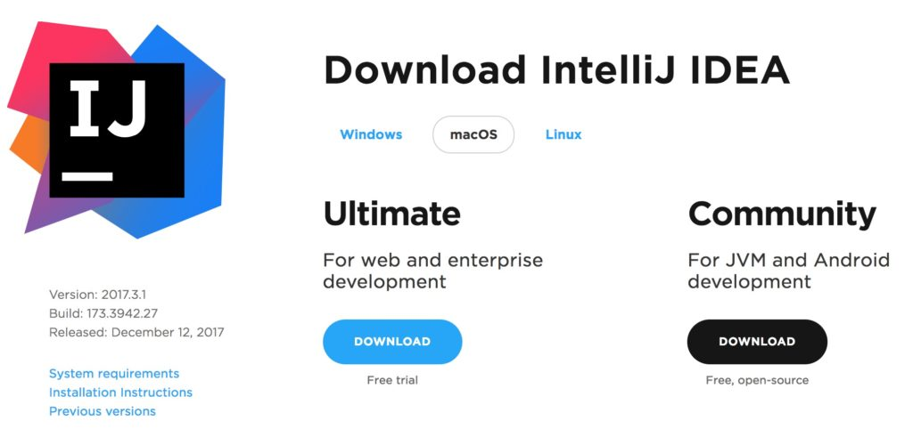
Official Website
Open your browser and go to https://www.jetbrains.com/idea/
Click Download on the IntelliJ IDEA page.
Choose your Operating System (Windows, macOS, or Linux).
Select Community Edition (recommended for students).

Slide 3
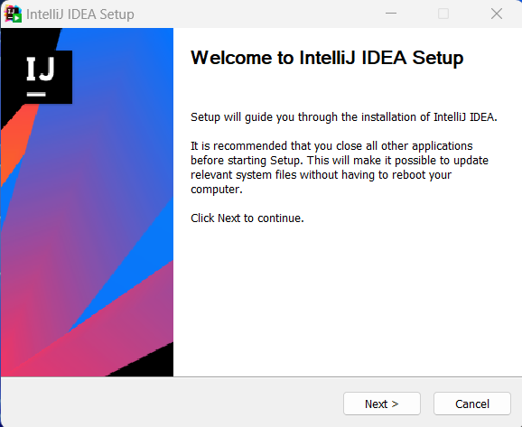
Run the Installer
Locate the downloaded setup file (e.g., ideaIC-2025.exe).
Double-click to start installation.
Choose installation location and components (like 64-bit launcher).
Click Install and wait until the setup completes.

Slide 4
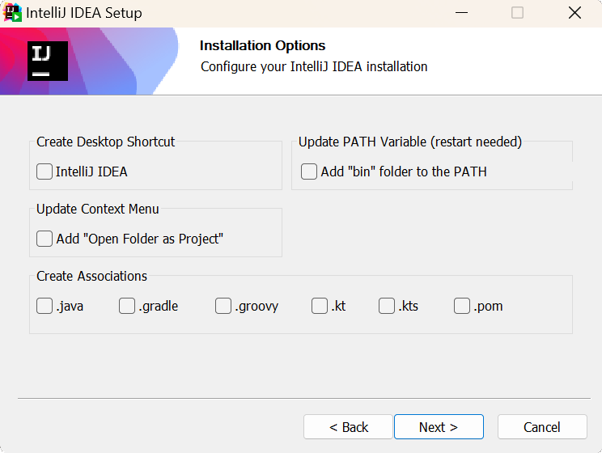
First Launch Setup
After installation, open IntelliJ IDEA from the Start Menu.
Import settings (or choose Do not import settings).
Select a UI theme – Light or Dark.
The IDE may download updates or plugins on first launch.

Slide 5
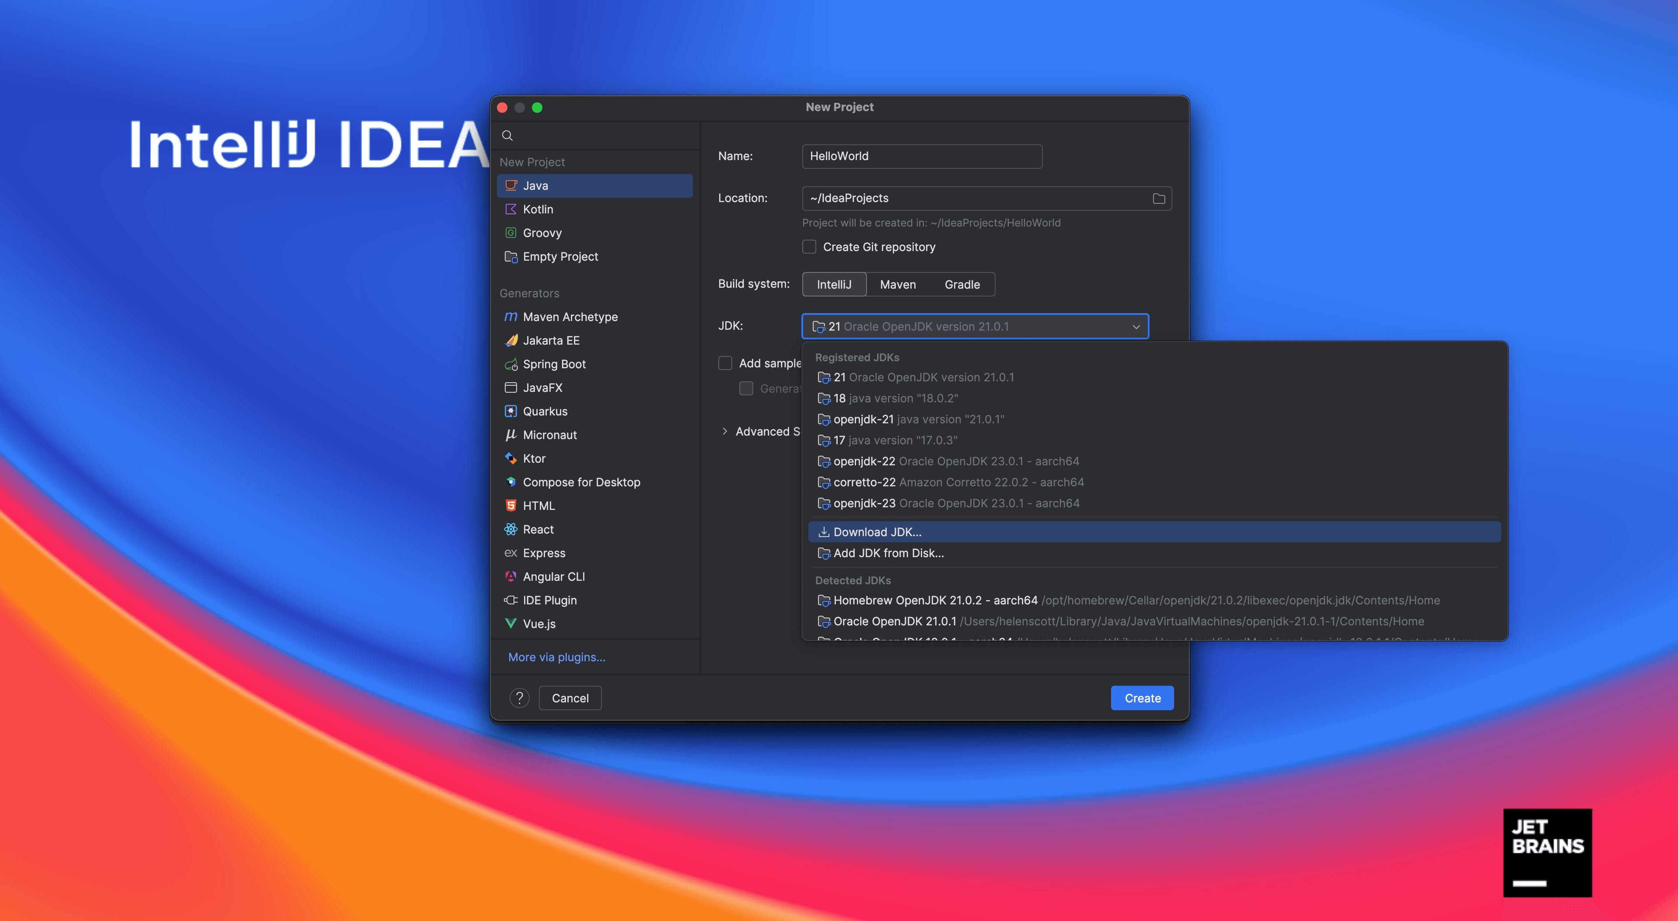
Create Your First Project
Click New Project.
Choose Java and make sure you have JDK installed.
Set project name and location.
Click Create, and you’re ready to code!

Slide 6

Conclusion
IntelliJ IDEA makes Java development easier and faster.
With plugins, it also supports Kotlin, Python, HTML, and more.
Now you’re ready to start your programming journey!

Slide 7
THANK YOU
BISMAYA ANEESH
CSA1D1

